Slide 1



CI/CD series
CI/CD with Jenkins
© 2017 - 2018 Siam Chamnankit Company Limited. All rights reserved.

Slide 2



Slide 3
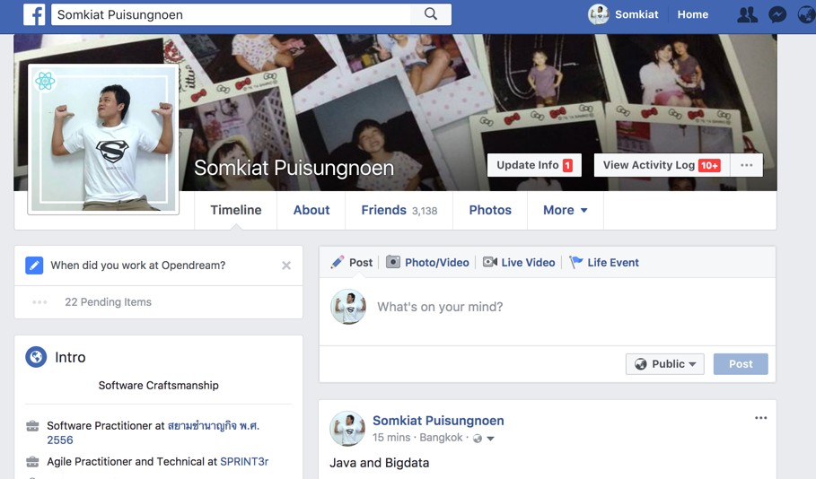

Slide 4


Slide 5
Agenda Day 1
Concept of Continuous Integration
Concept of Continuous Delivery/Deployment
Practices of Continuous Integration
Build pipeline
Build your CI/CD system with Jenkins
Installation and Configuration Jenkins
Build your pipeline
Workshop

Slide 6
Agenda Day 2
Working with automated testing
Working with code quality
Automated deployment with Jenkins
Pipeline as a Code with Jenkins
Backup and Restore
Scalable Jenkins with Master/slave
Introduction to DevOps
Workshop

Slide 7
https://github.com/up1/course- ci-cd-with-jenkins

Slide 8
Continuous Integration

Slide 9
Why CI/CD ?

Slide 10
The cost of integration
Merging the code
Duplicate changes
Test again again !!
Fixing bugs
Impact on stability

Slide 11
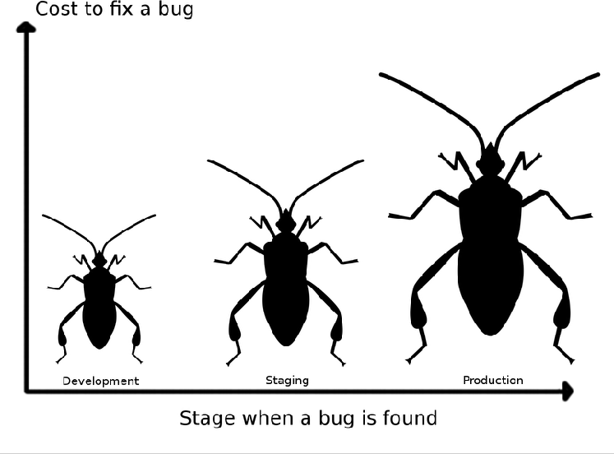
The cost of integration

Slide 12
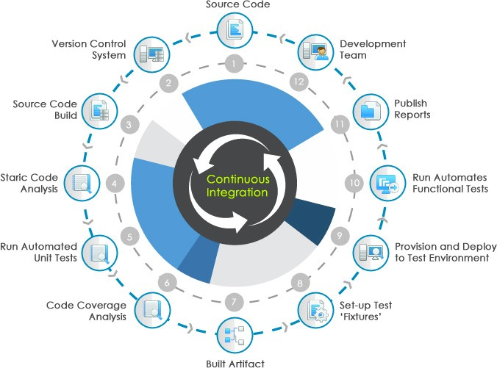

Slide 13










Slide 14









CI is about what people do not about what tools they use

Slide 15

Continuous Integration
Discipline to integrate frequently

Slide 16

Continuous Integration
Strive to make small change

Slide 17

Continuous Integration
Strive for fast feedback

Slide 18
Practices of
Continuous Integration

Slide 19
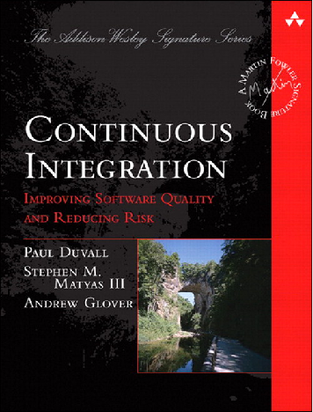

Improve quality and reduce risk

Slide 20
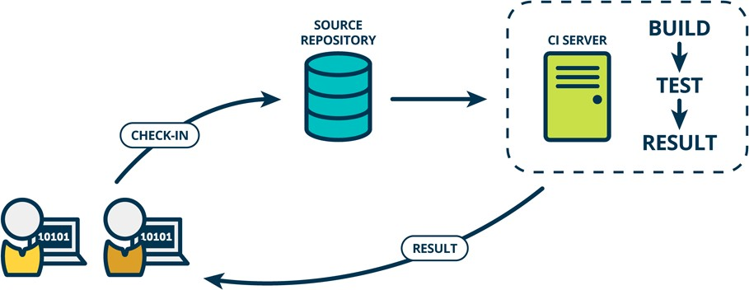
Continuous Integration

Slide 21
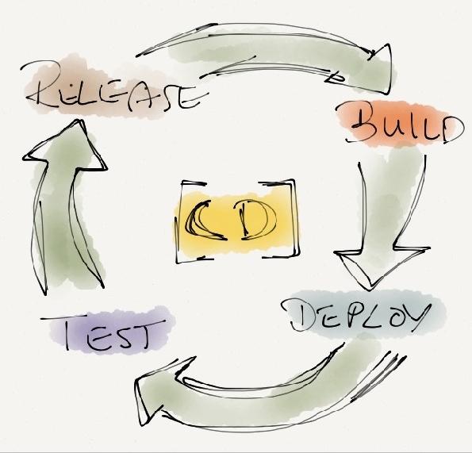
CD ?

Slide 22
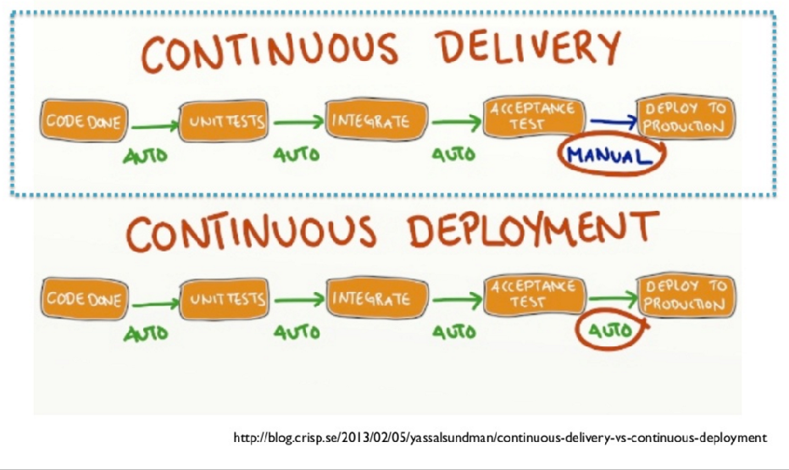
CD ?

Slide 23
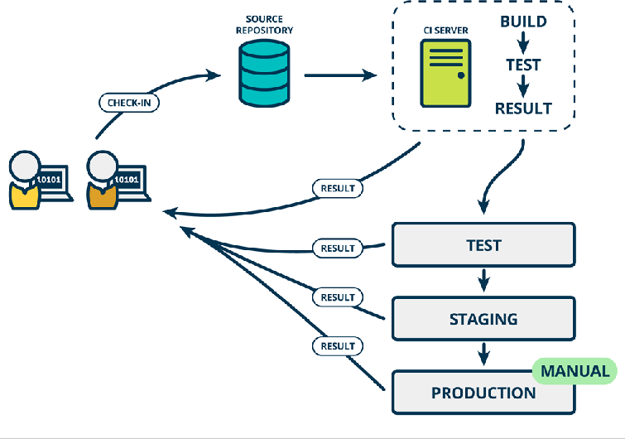
Continuous Delivery

Slide 24
Rise of DevOps

Slide 25
Continuous Integration
is a Software development practices

Slide 26

Practice 1
Maintain a single source repository
In general, you should store in source control everything you need to build anything

Slide 27

Practice 2
Automated the build Automated environment for builds

Slide 28
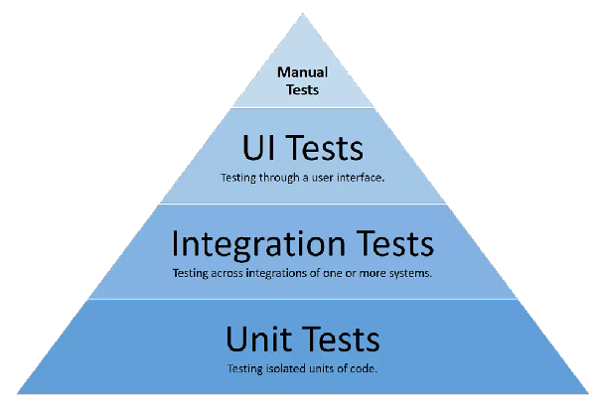
Practice 3
Make your build self-testing
Build process => compile, linking and testing

Slide 29
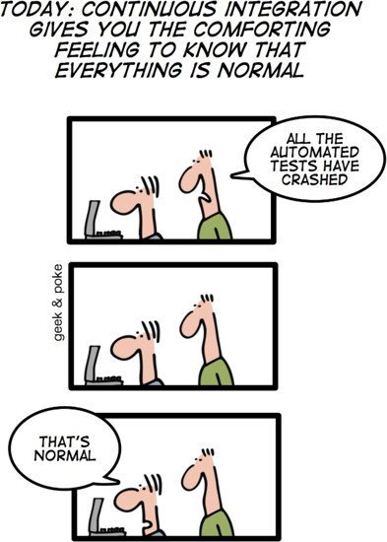
http://geekandpoke.typepad.com/

Slide 30

Practice 4
Everyone commits to the mainline everyday Integration is about communication
Integration allows developers to tell other developers

Slide 31
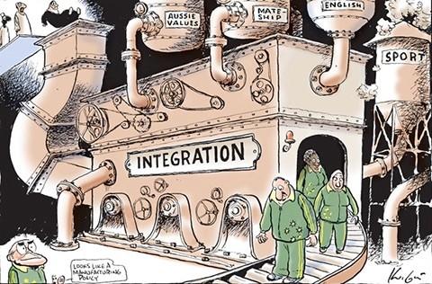
Practice 5
Every commits should build the mainline on an
Integration machine

Slide 32
Nightly build is not enough for Continuous Integration

Slide 33

Practice 6
Fix broken builds immediately
“Nobody has a higher priority task than fixing the build”

Slide 34

Practice 7
Keep the build fast
Continuous Integration is to provide rapid feedback

Slide 35
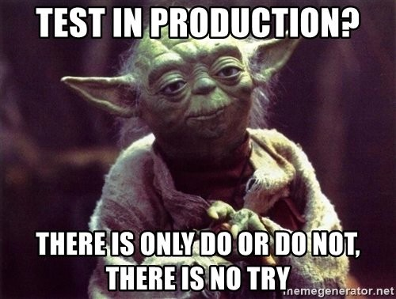
Practice 8
Test in clone of the Production environment

Slide 36

Practice 9
Make it easy for anyone to get the latest executable
Make sure well known place where people can find

Slide 37

Practice 10
Everyone can see what’s happening
Easier to see the state of the system and changes Show the good information

Slide 38
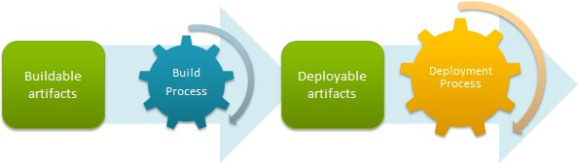
Practice 11
Automated deployment

Slide 39
Practice 11
Automated deployment

Slide 40
Continuous Delivery

Slide 41
Continuous Delivery
Use version control for all production artifacts Automate your deployment process Implement continuous integration (CI)
Use trunk-based development methods Implement test automation
Support test data management
Integrate security into software development process

Slide 42
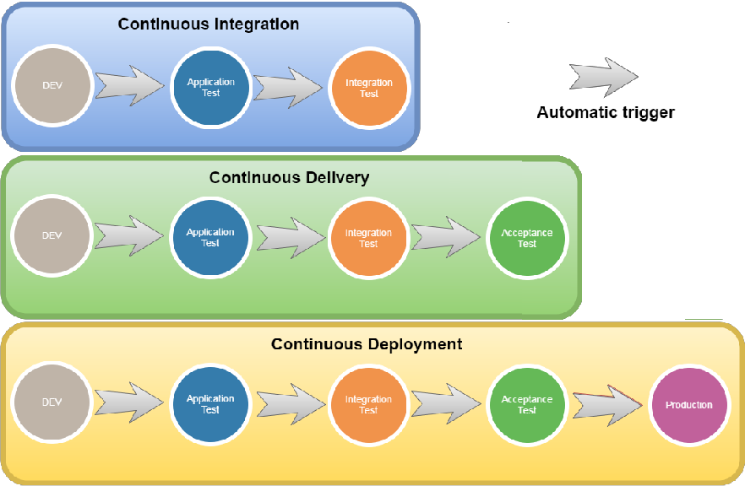

Slide 43
How to achieve the CI ?

Slide 44

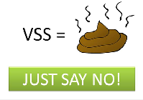

1. Use good version control
Local Centralize Distributed

Slide 45
2. Choose Branch strategy
Main only Development isolation Feature isolation Release isolation
Service and Release isolation Service, Hotfix and Release isolation

Slide 46
Main only

Slide 47
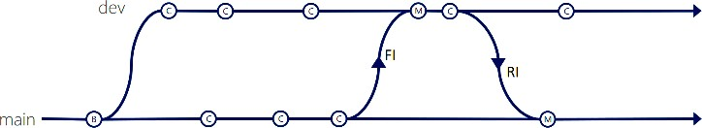
Development isolation

Slide 48
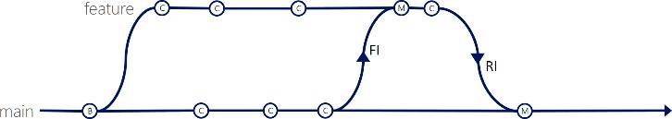
Feature isolation

Slide 49
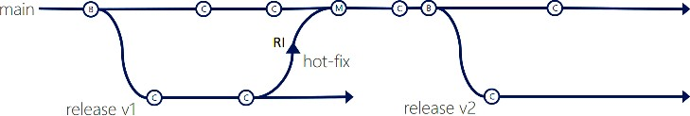
Release isolation

Slide 50
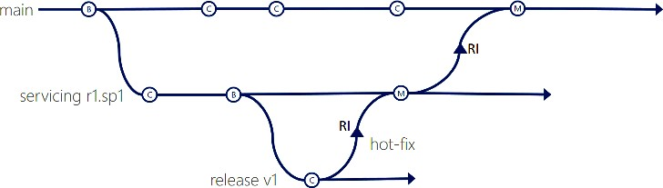
Service and Release isolation

Slide 51
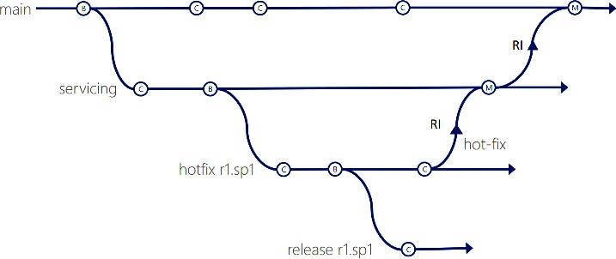
Service, Hotfix, Release isolation

Slide 52
Validate, Validate and Validate

Slide 53

Suggestion
Keeping branches short-lived, merge conflicts are keep to as few as possible

Slide 54
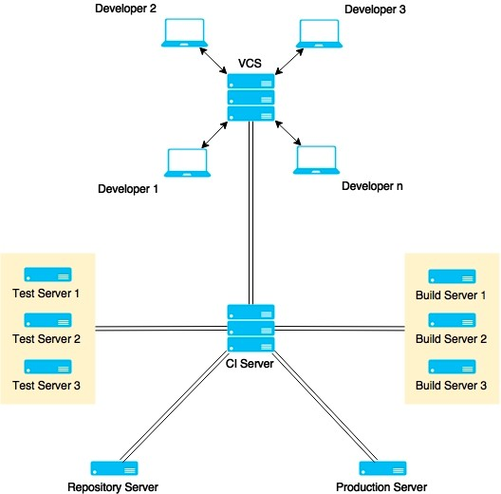
3. Use good CI tool

Slide 56
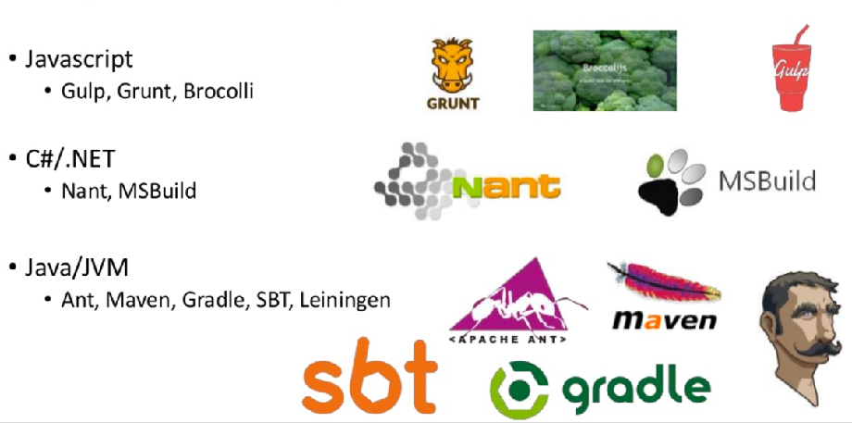
4. Use good build tool

Slide 57
More …
Use static code analysis Automated testing Automated deployment People discipline/habit

Slide 58
“Behind every successful agile project, there is a
Continuous Integration Server”

Slide 59
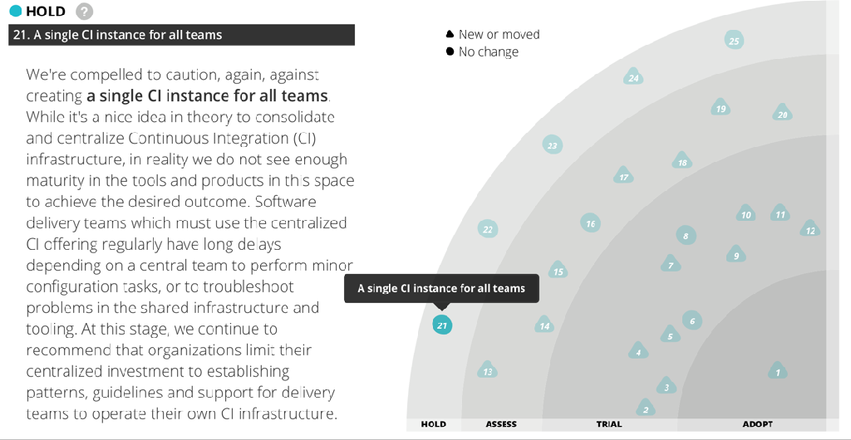
Anti-pattern for CI Server
https://www.thoughtworks.com/radar/techniques

Slide 60
Let’s start with CI/CD

Slide 61

Application and framework to manage and monitor the executable of repeated tasks
https://jenkins.io/

Slide 62
Centralize Continuous Integration Server
https://jenkins.io/

Slide 63
Why Jenkins ?
Easy !!
Extensible Scalable Opensource Large community Lot of plugins

Slide 64
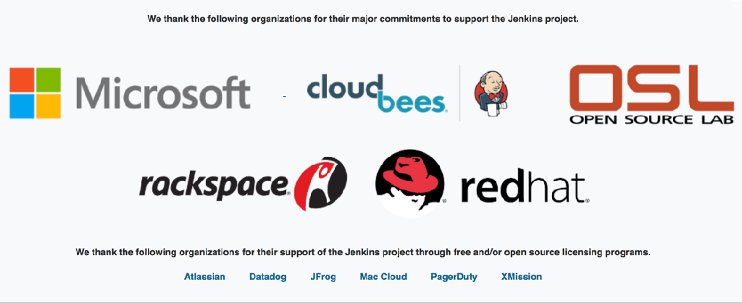
Who use Jenkins ?
https://jenkins.io/

Slide 65
Hardware requirements
For Jenkins server RAM +2GB
More CPU More Disk

Slide 66
Installation

Slide 67
Jenkins in containers
Apache Tomcat Jetty JBoss
Websphere WebLogic Glassfish

Slide 68
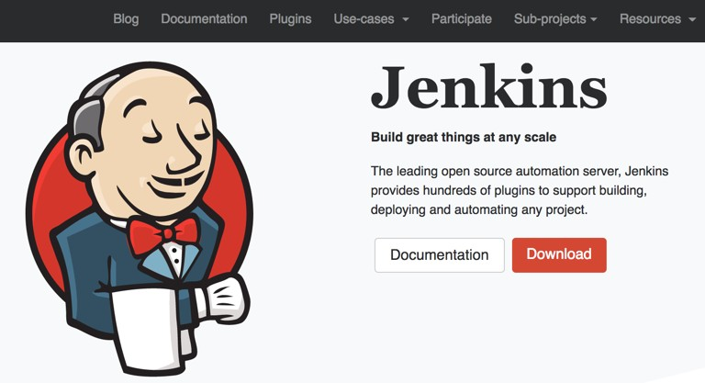
Download Jenkins
https://jenkins.io/

Slide 69
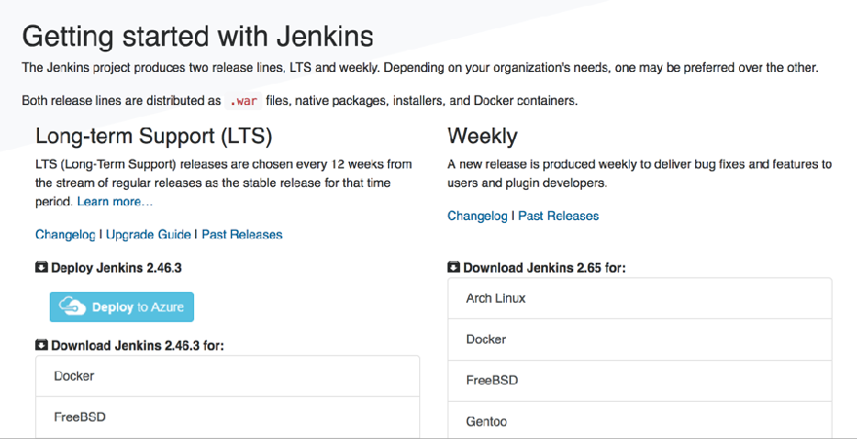
Use Long Term Support (LTS)

Slide 70
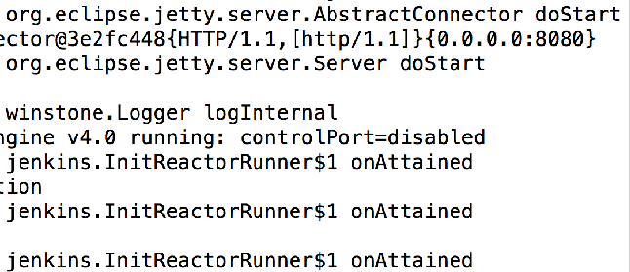
Start Jenkins
$java -jar jenkins.war
Default port of server is 8080

Slide 71
Change port of Jenkins
$java -jar jenkins.war --httpPort=<port>

Slide 72
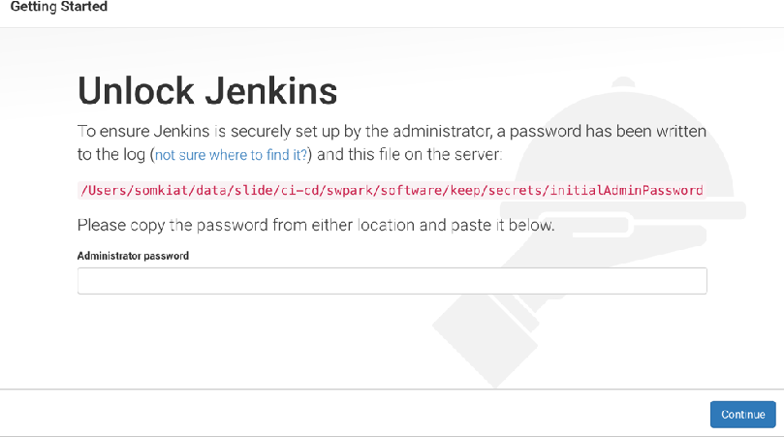
Open in browser
http://localhost:8080

Slide 73
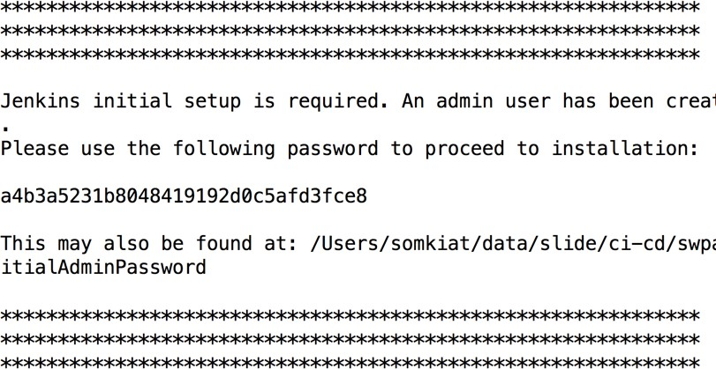
Copy password from console

Slide 74
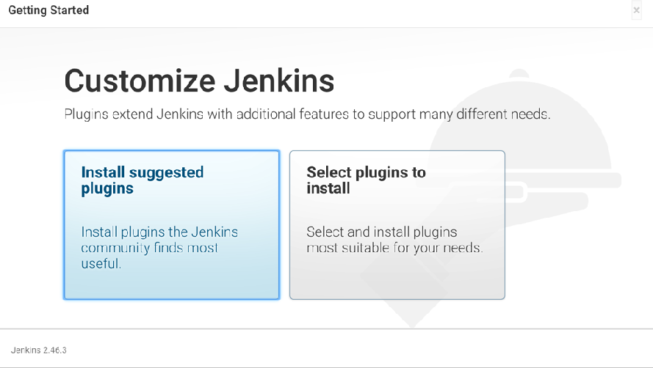
Customize plugins

Slide 75
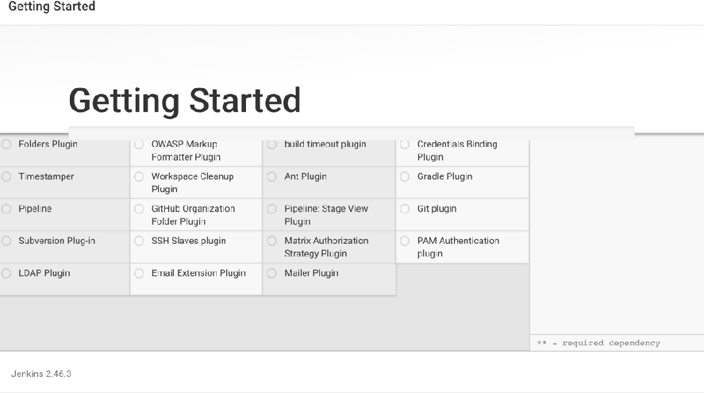
Waiting

Slide 76
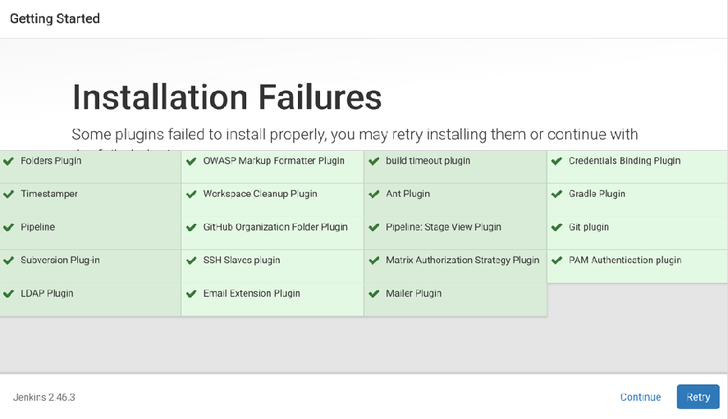
Success

Slide 77
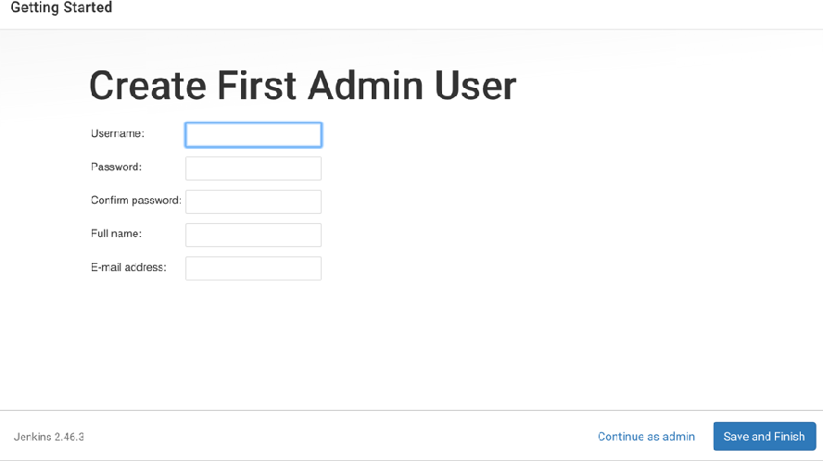
Create a new user

Slide 78
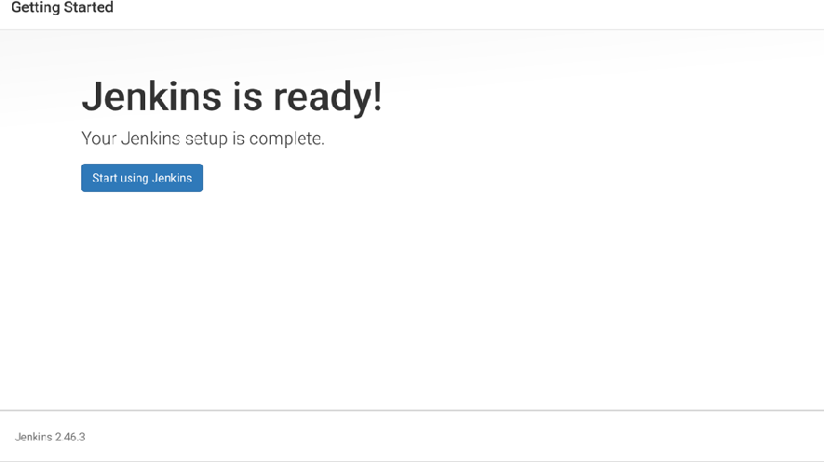
Ready to use

Slide 79
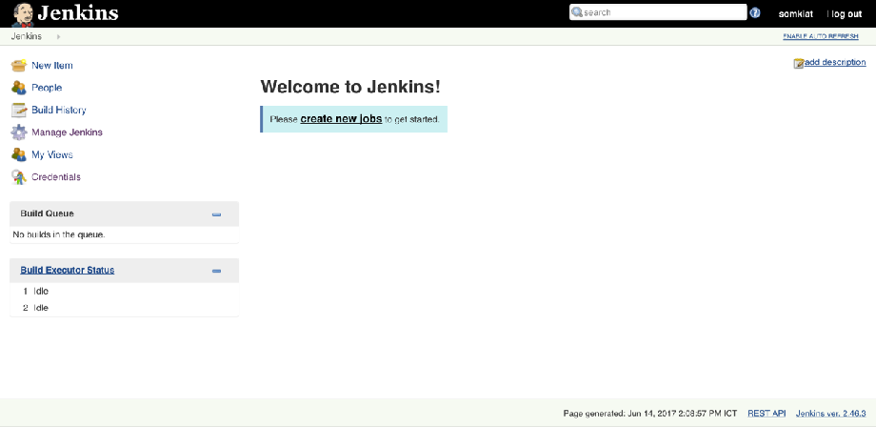
Welcome to Jenkins

Slide 80
About Jenkins’s HOME
Default of JENKINS_HOME is
<path of user>/.jenkins

Slide 81
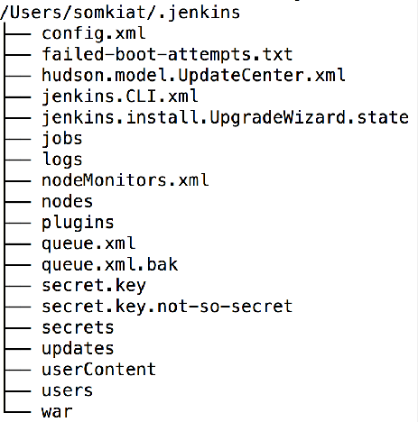
About Jenkins’s HOME
Data in JENKINS_HOME

Slide 82
About Jenkins’s HOME
File and Folder name Description
config.xml | All about configuration
jobs | Keep all jobs/project
plugins | Keep all plugins
nodes | Keep all nodes
logs | Keep all logs

Slide 83
Change Jenkins’s HOME
For Windows
set JENKINS_HOME=<your path>
For Linux/Mac
export JENKINS_HOME=<your path>
try to restart Jenkins …

Slide 84
Disable Jenkins’s security

Slide 85
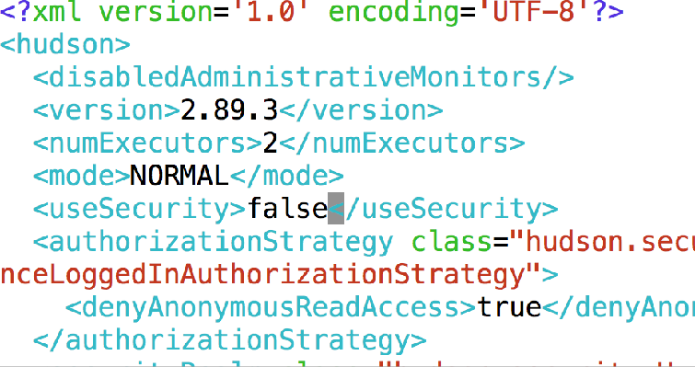
Set useSecurity=false
<JENKINS HOME>/config.xml

Slide 86
Learn to use Jenkins in the right way

Slide 87
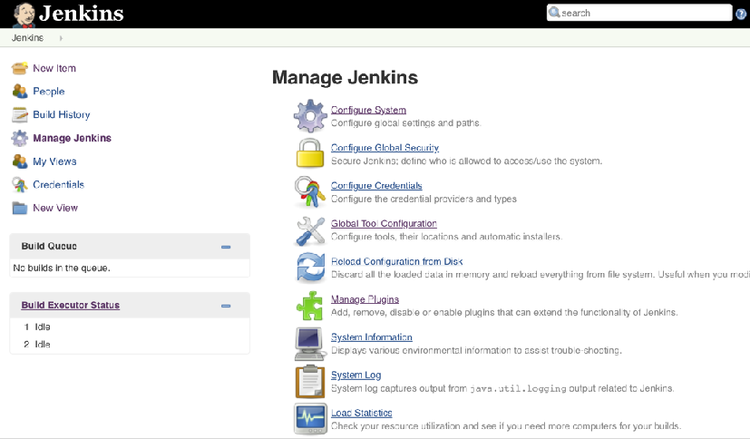
Manage Jenkins
For Administrator to config anything in Jenkins

Slide 88
Configure System
Global setting and paths

Slide 89
Configure System
JENKINS Home
# of executors Label name of node
Environment variables Email notification

Slide 90
Configure Global Security
Setting for secure Jenkins

Slide 91
Global Tool Configuration
Config tools, location and automatic installers

Slide 92
Global Tool Configuration
Apache Maven
JDK (Java Development Kit) Git
Gradle Docker

Slide 93
Manage Plugins
Add, remove, enable/disable plugins

Slide 94
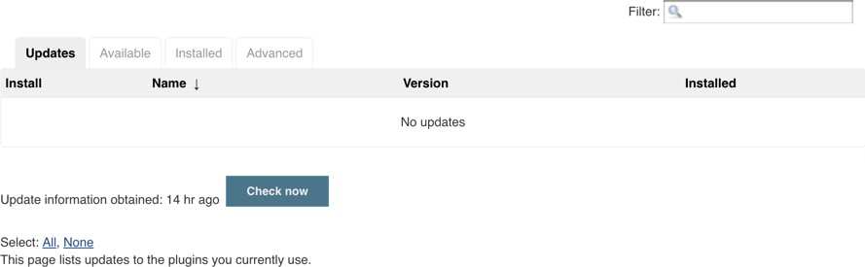
Manage Plugins
Add, remove, enable/disable plugins

Slide 95
Manage Plugins
Filter plugins

Slide 96
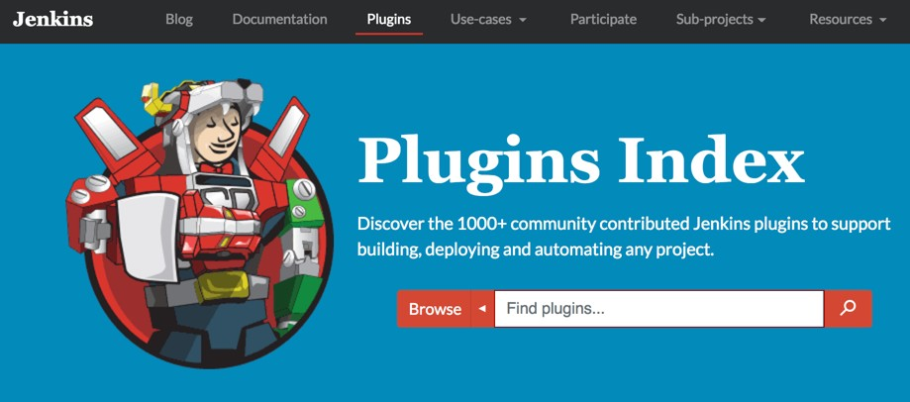
Finds Jenkins’s plugin
https://plugins.jenkins.io/

Slide 97
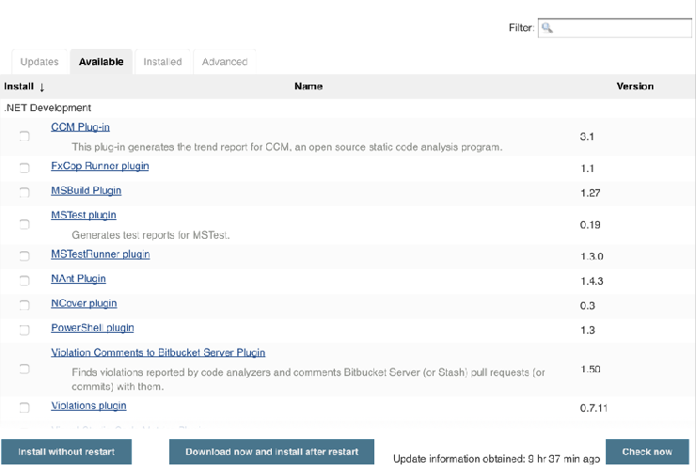
Try to install a first plugin
Choose Available tab and select a plugin

Slide 98
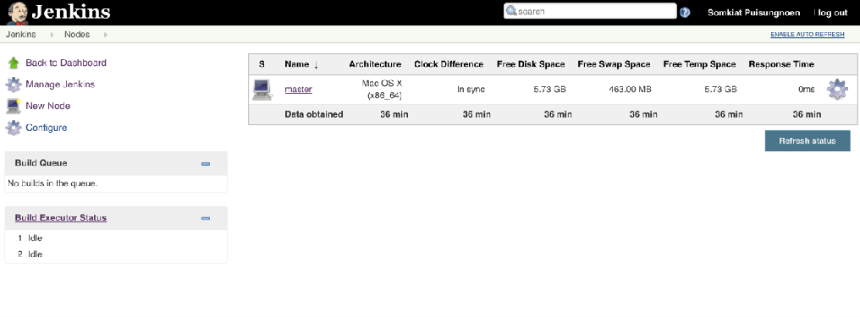
Manage Nodes
Add, remove, status of nodes

Slide 99
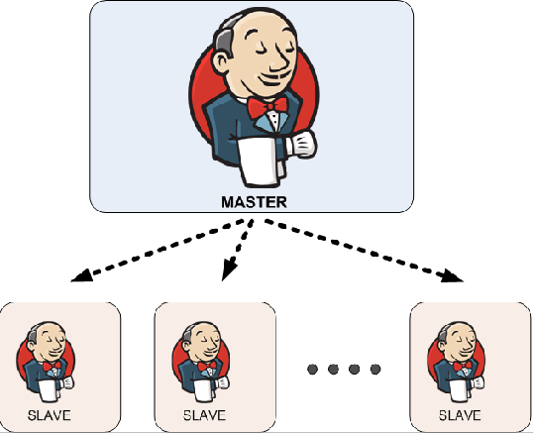
Manage Nodes
Master-slave concept to scale Jenkins

Slide 100
Create a first Job

Slide 101
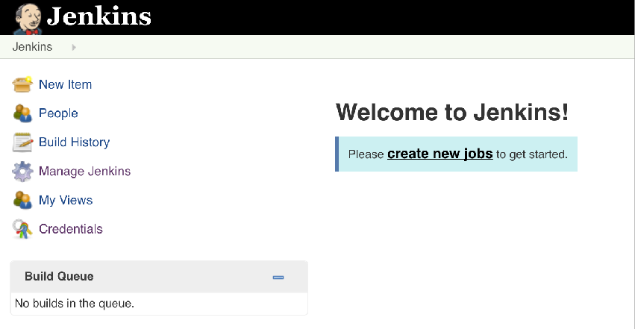
1. Create a new job

Slide 102
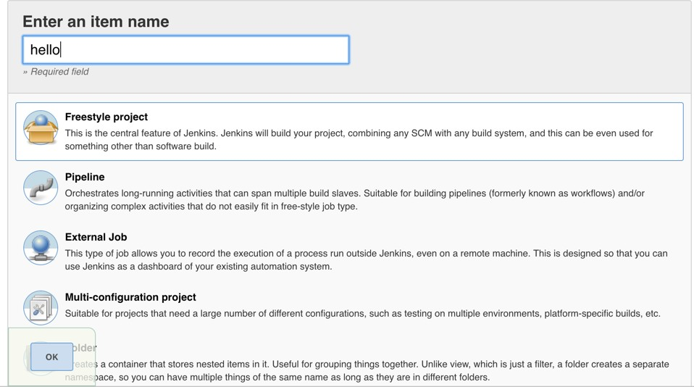
2. Fill in a job name

Slide 103
3. Choose type of job

Slide 104
3. Choose type of job

Slide 105
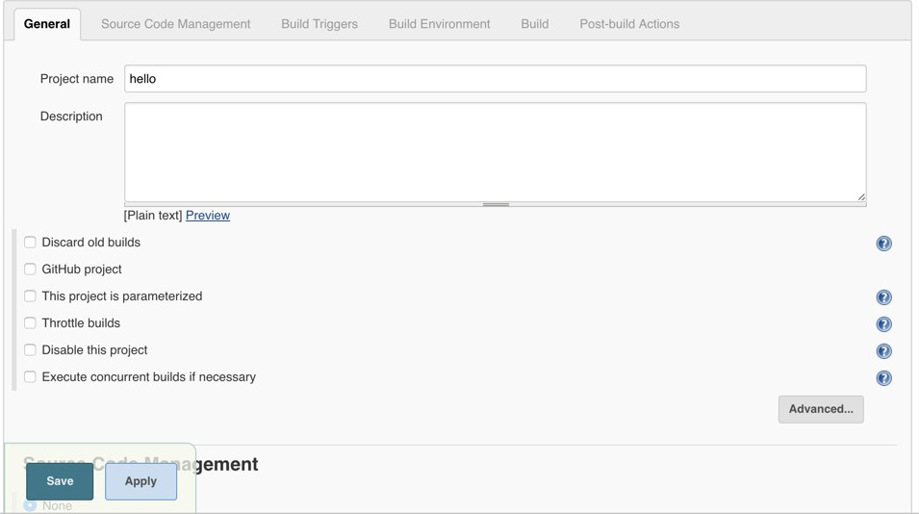
4. General section

Slide 106
4.1 Advanced options

Slide 107
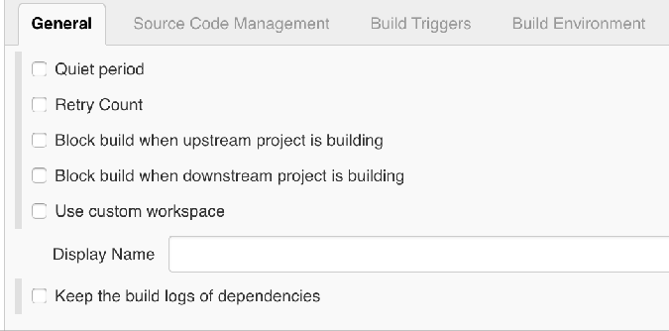
4.1 Advanced options

Slide 108

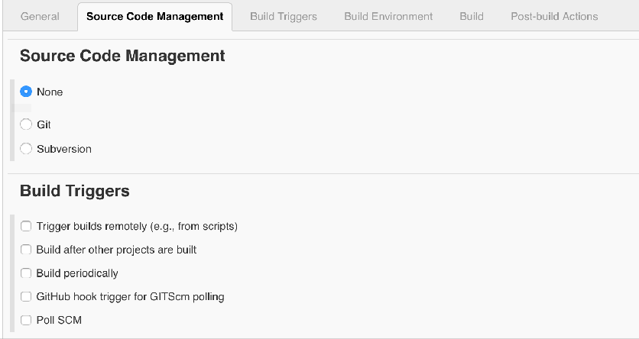
5. Source code management
By default is Git and Subversion

Slide 109

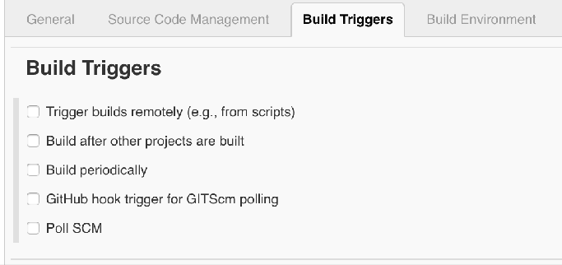
6. Build trigger
When to run this job

Slide 110

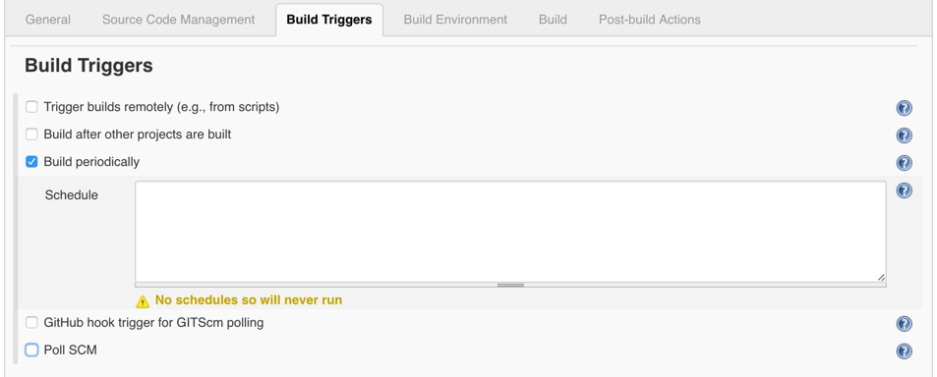
6.1 Periodically
H 23 * * *

Slide 111

6.2 Poll SCM

Slide 112


7. Add build step
What to run this job

Slide 113


7.1 For Windows

Slide 114
7.2 For Linux/Mac

Slide 115
8. Post build actions
Generate reports Send email
Run other jobs/projects

Slide 116


8. Post build actions

Slide 117

9. Run your job
Manual and Scheduler run

Slide 118
9. Run your job
Start build your job

Slide 119

9. Run your job
Start build your job

Slide 120

9. Run your job
See your job’s output

Slide 121

10. See job’s status
By default is Blue, Red and Gray
Blue = build success Red = build failure
Gray = disabled/never executed

Slide 122
11. See job’s health
Sunny = 100% success rate Cloudy = 60% success rate Raining = 40% success rate

Slide 123
Let’s workshop

Slide 124
Backup your Jenkins

Slide 125

Backup your Jenkins
All data that must be backup

Slide 126


Backup your Jenkins
What to backup ? When to backup ?
How to backup ?

Slide 127
Backup your Jenkins
Try to create new Jenkins’s job to backup How to backup ?

Slide 128

We use 7zip to compress files
http://www.7-zip.org/

Slide 129
Write your backup script

Slide 130
For Windows
Windows
REM Store the current date inside a variable named "DATE"
for /f %%i in ('date /t') do set DATE=%%i REM 7-Zip command to create an archive "C:\Program Files\7-Zip\7z.exe" a -t7z
C:\Jenkins_Backup\Backup_%DATE%.7z C:\Jenkins\*

Slide 131
For Linux/Mac
Mac OS
for /f %%i in ('date /t') do set DATE=%%i
7z a -t7z $BACKUP\Backup_$DATE.7z $JENKINS_HOME\*

Slide 132
Ready to start with Jenkins

Slide 133

1. Create a new job
Job name = backup_jenkins

Slide 134

2. Add build trigger
Using Build periodically => H 23 * * 7

Slide 135

3. Build
Choose way to run a script

Slide 136

3. Build
Copy and paste your script to Jenkins

Slide 137

4. Save and run

Slide 138

5. See console output

Slide 139

6. See your backup file

Slide 140
Upload file to somewhere ?
Restore from backup file ?

Slide 141
Backup with plugin

Slide 142

1. Backup with plugin
Install plugin = Periodic Backup Plugin
1
https://plugins.jenkins.io/periodicbackup

Slide 143

2. Install plugin
2

Slide 144

3. Using plugin
Manage Jenkins -> Periodic Backup Manager

Slide 145

3. Using plugin
Try to configure backup plugin

Slide 146
3. Using plugin
Temporary directory of achieve files while restore and backup process

Slide 147
3. Using plugin
Backup schedule is a crontab format

Slide 148
3. Using plugin
Maximum backups in location is total # of backups

Slide 149
3. Using plugin
Store no older than (days), delete backups < days

Slide 150

4. Example of configuration

Slide 151

5. File management strategy
ConfigOnly is backup only configuration

Slide 152

5. Backup locations

Slide 153
Try to run your job

Slide 154
Jenkins driven by Plugins !!

Slide 155
Workshop with Java Web Application

Slide 156

Pipeline of this project

Slide 157

Suggestion
“Must setup/configuration CI server before the first feature”

Slide 158
Tools for development
Technology | Description
Java | Main programming language
Apache Maven | Build tool
JUnit | Unit and integration test tool
Cobertura | Code coverage tool
Robotframework | Acceptance test tool
Apache Tomcat | Java Web Server
Git | Version Control System
SonarQube | Static code analysis tool
Frog Artifactory | Keep artifact files
Jenkins | Continuous Integration Server
IntelliJ IDEA | IDE for Java development

Slide 159
Try to install toolsets !!

Slide 160

1. Git
Distributed version control system
https://git-scm.com/

Slide 161

2. JDK 1.8
Java Development Kit 1.8 from Oracle
http://www.oracle.com/technetwork/java/javase/downloads/jdk8-downloads-2133151.html

Slide 162

3. Apache Maven
Dependency management tool for Java project
http://maven.apache.org/

Slide 163
4. Artifactory Server
Sonatype Nexus Repository Frog Artifactory

Slide 164

4.1 Sonatype Nexus Repository
To keep the artifact such as JAR/WAR/EAR file
https://my.sonatype.com/

Slide 165

Start nexus server
$nexus start
http://localhost:8081

Slide 166

Login
user = admin password = admin123

Slide 167

4.2 JFrog Artifactory
To keep the artifact such as JAR/WAR/EAR file
https://jfrog.com/open-source/

Slide 168

5. SonarQube
To analyze the source code of project
https://www.sonarqube.org

Slide 169

Start SonarQube Server
http://localhost:9000

Slide 170

Login
user = admin password = admin

Slide 171

6. Apache Tomcat
Java Web Server to run Java application
http://tomcat.apache.org/

Slide 172
Configure software in Jenkins

Slide 173

JDK
Manage Jenkins -> Global tool configuration

Slide 174

Git
Manage Jenkins -> Global tool configuration

Slide 175

Apache Maven
Manage Jenkins -> Global tool configuration

Slide 176
Let’s create pipeline with Jenkins

Slide 177

1

Slide 178



1. Working with Git
Pull source code from Git provider such as Github Keep source code in Job’s workspace
Poll
Jenkins’s Job
Git provider
Trigger via hook

Slide 179
Example code
https://github.com/up1/workshop-java-web-tdd

Slide 180

Step 1 Create new job
Job name = step01_pullcode

Slide 181

Step 2 Source code management
Add url of git provider repository

Slide 182

Step 3 Manual build job
Add url of git provider repository

Slide 183

Step 4 See result
See all source code in workspace

Slide 184

Step 4 See result
See all source code in workspace

Slide 185
Step 4 See result
Build History keep in logs file !!

Slide 186


Where is your data ?
In JENKINS’s HOME

Slide 187

Where is your data ?
In JENKINS’s HOME

Slide 188
Be careful !!
Harddisk Full

Slide 189

Need to manage the build history
Choose Discard old builds in General tab

Slide 190

Discard old builds
Default Strategy is LogRotation that have 2 options
Days to keep build
Maximum # of build to keep

Slide 191

Discard old builds
If you need more, see in plugins section

Slide 192

Step 5 Add Build Triggers
Use Poll SCM to check any changes from repos
* * * * *

Slide 193
Schedule setting
Use a crontab format
Name | Description
Minute | Minutes within the hour (0–59)
Hour | The hour of the day (0–23)
DOM | The day of the month (1–31)
Month | The month (1–12)
DOW | The day of the week (0–7) where 0 and 7 are Sunday.

Slide 194
Try it by yourself

Slide 195
2

Slide 196
3

Slide 197
2. Compile and run unit tests
JDK
Apache Maven JUnit

Slide 198
How to compile and test ?
We using the Apache Maven to manage
$mvn clean package

Slide 199



Add build steps
1
mvn clean package
2

Slide 200



Try to run and see output
Scroll down to button and see Success status

Slide 201
Consideration for output
Compile was success
Testing was success
Create artifact file or WAR file was success
Test/code coverage was success

Slide 202






Suggestion
We need to separate to more jobs
step01_pullcode
step02_compile
step03_unittest
step04_coverage
step05_package

Slide 203
Step to run each job
Using Apache maven
Step | Command
Compile | mvn clean test
Unit test | mvn clean test
Coverage | mvn clean package
Package/Artifact | mvn clean package

Slide 204

Create new job to compile&test
Job name = step02_build

Slide 205

Add build steps
mvn clean test

Slide 206
Problem !!
Where is a source code ?

Slide 207


Source code from step01
step01_pullcode
step02_build
$JENKIN_HOME/workspaces

Slide 208

Source code from step01
General => Advances => Use custom workspace
${JENKINS_HOME}/workspace/step01_pullcode

Slide 209

Try to manual build
All source code that you need to compile and test

Slide 210
Try it by yourself

Slide 211
Generate test result report

Slide 212

Generate test result
Post-build Actions => Publish JUnit test result report

Slide 213

Generate test result
Set path of test reports (XML files)
target/surefire-reports/*.xml

Slide 214

Generate test result
See result of testing, trending of testing

Slide 215

Generate test result
Detail of result in each package

Slide 216
Generate code coverage report

Slide 217
Code coverage tools
Cobertura
Jacoco
Clover

Slide 218

Install Cobertura plugin

Slide 219

Install Jacoco plugin

Slide 220

Install Clover plugin

Slide 221

Using Cobertura in job
Post-build Actions => Publish cobertura coverage report

Slide 222

Using Cobertura in job
Post-build Actions => Publish cobertura coverage report
**/target/site/cobertura/coverage.xml

Slide 223

Using Cobertura in job
Advances => Coverage Metric Targets
Target must come from from Deliver team !!

Slide 224

See result of report

Slide 225

See result of report

Slide 226

See result of report

Slide 227


One more thing !!
step01_pullcode
step02_build

Slide 228

Build other projects
Configure in job’s step01_pullcode Post-build actions => Build other projects

Slide 229

Build other projects
Specified project name = step02_build

Slide 230

Try to build job = step01_pullcode
Downstream projects ?

Slide 231

See step02_build
Upstream projects ?

Slide 232
Need to see result ?
step01_pullcode
step02_build

Slide 233

Install Build pipeline plugin

Slide 234

Create Build pipeline in view

Slide 235

Create Build pipeline in view
Fill in view name and choose build pipeline view

Slide 236

Create Build pipeline in view
Choose a initial job (Start job)

Slide 237

Build pipeline in view

Slide 238
4

Slide 239
4. Code analysis
Working with SonarQube Start SonarQube server

Slide 240

Step 1 Install SonarQube plugin

Slide 241



Step 2 Install SonarQube Scanner
Send analyzed result to SonarQube server
SonarQube scanner
SonarQube server
Run on Jenkins’s Job

Slide 242

Step 3 Install Sonar Scanner
https://docs.sonarqube.org/display/SCAN/Analyzing+with+SonarQube+Scanner

Slide 243

Step 4.1 Configure SonarQube scanner
Manage Jenkins => Global Tool Configuration

Slide 244

Step 4.2 Configure SonarQube server
Manage Jenkins => Configuration System

Slide 245

Step 5 Create a new job
Job name = step06_analyze

Slide 246

Step 5 Create a new job
Tips copy from other project

Slide 247

Step 6 Add SonarQube to Build step
Build => Execute SonarQube Scanner

Slide 248

Step 6 Add SonarQube to Build step
Configure your build

Slide 249

Step 7 Add sonar-project.properties
Configuration file of project for SonarQube

Slide 250
Example sonar-project.properties
sonar.projectKey=java-example sonar.projectName=java-example sonar.projectVersion=1.0
sonar.sources=src sonar.java.source=src/main/java sonar.java.binaries=target/classes sonar.language=java sonar.sourceEncoding=UTF-8
sonar.junit.reportPaths=target/surefire-reports

Slide 251

Step 8 Run and See result

Slide 252

Step 8 Run and See result
Result in Sonarqube server

Slide 253
Try it by yourself

Slide 254
5

Slide 255
5. Package and Deploy

Slide 256







5.1 Package and Deploy
Try to build WAR file and send to Nexus Repos Try to deploy WAR file to WebServer
1
2
Artifact WAR file
Artifact Server
Deploy to Server

Slide 257
Setup Nexus Repository

Slide 258
Step 0 Start server
$nexus /run
$nexus run
#For Windows #For Linux/Mac
https://help.sonatype.com/repomanager3/installation/installation-methods

Slide 259

Go to <server>:8081

Slide 260

Step 1 Try login to JFrog Artifactory
admin admin123

Slide 261

Step 2 Go to administrator section

Slide 262

Step 3 Select repositories menu

Slide 263
Step 4 Create repository

Slide 264

Step 5 Choose raw (hosted)

Slide 265

Step 6 Fill in name of repos
demo_web

Slide 266

Step 7 Create new job
job name = step07_upload

Slide 267

Step 8 Add build step
Choose Execute shell/windows batch command

Slide 268
Step 8 Add build step
Choose Execute shell/windows batch command
curl -v --user 'admin:admin123'
--upload-file ./demo.war http://localhost:8081/repository/demo_web/
$BUILD_NUMBER/demo.war

Slide 269

Step 9 Run and see result in nexus

Slide 270

If you need the plugins !!

Slide 271

Config Nexus Artifact Uploader
Use to upload artifact file to Nexus Repository Add build step => Nexus artifact uploader

Slide 272

See result in Nexus Artifactory

Slide 273
Let’s try by yourself

Slide 274

5.2 Package and Deploy
Try to build WAR file and send to Frog Artifactory Try to deploy WAR file to WebServer
1
2
Artifact WAR file
Artifact Server
Deploy to Server

Slide 275
Setup JFrog Artifactory

Slide 276

Step 1 Try login to JFrog Artifactory
admin
password

Slide 277

Step 2 Create local repository

Slide 278

Step 3 Choose Generic repos

Slide 279

Step 3 Choose Generic repos
Fill in name of repo = dev

Slide 280

Step 4 Install Artifactory plugin

Slide 281

Step 5 Configure Artifactory plugin
Manage Jenkins => Configure System

Slide 282

Step 6 Add to build steps
Build Environments => Generic-Artifactory Integration

Slide 283

Step 6 Add to build steps
Configure job to upload
target/*.war=>${BUILD_NUMBER}

Slide 284

Step 7 Run and see output
See in Artifactory Server

Slide 285

Step 7 Run and see output
See in Jenkins’s job

Slide 286
6

Slide 287
6. Deploy to other server
Try to deploy WAR file to WebServer
Apache Tomcat
JBoss
IBM Websphere Web Logic

Slide 288

6. Deploy to other server
Deploy WAR file from Artifact Server to Web Server
1
Artifact WAR file
Artifact Server
Deploy to Server
2
WebServer

Slide 289

6. Deploy to other server
Deploy WAR file from Artifact Server to Web Server
1
Artifact WAR file
Artifact Server
Deploy to Server
2
WebServer

Slide 290

Deploy to container plugin

Slide 291

Add to Post-build actions
Post-build actions =>Deploy war/ear to a container

Slide 292

Deploy war/ear to a container
Specify WAR/EAR file to deploy

Slide 293
Where is my WAR file ?

Slide 294
Download WAR file from Repository

Slide 295

Download with command line
Add step in build step of job
curl -X GET -o demo.war -u admin:admin123
<url of artifact server>/demo.war

Slide 296
Try to deploy WAR

Slide 297

Deploy war/ear to a container
Choose a container to deploy

Slide 298

Deploy war/ear to a container
Config credential and Tomcat URL

Slide 299

Deploy fail
Need username and password ?

Slide 300
Setup Apache Tomcat
Add user and roles in file tomcat-users.xml
<?xml version="1.0" encoding="UTF-8"?>
<tomcat-users>
<role rolename="manager-script"/>
<user username="deployer" password="password" roles=“manager-script"/>
</tomcat-users>

Slide 301

Add credential for deploy

Slide 302

Add credential for deploy

Slide 303

Try to build again and see output

Slide 304
How to manage version of WAR file ?

Slide 305
Manage version number
Send data/value between jobs ?
2
web_version=1
1
Artifact WAR file
Artifact Server
/1/demo.war
Deploy to Server
web_version=1
WebServer

Slide 306
Manage version number
Send data/value between jobs ?
step07_upload
step08_deploy
web_version=1

Slide 307
In job = step07_upload

Slide 308

Add post-build actions
In step07_upload

Slide 309

Add post-build actions
Add predefined parameters to send to other jobs

Slide 310

Add post-build actions
We send web_version=$BUILD_NUMBER

Slide 311
In job = step08_deploy

Slide 312

Receive parameters
Choose This project is parameterized

Slide 313

Try to use this parameter
$web_version in my build steps
wget --output demo.war -q
<url of artifact server>/$web_version/demo.war

Slide 314
7

Slide 315
7. Run acceptance tests
Try to test Web UI with Robotframework

Slide 316
Install Robotframework
$pip install robotframework
$pip install robotframework-selenium2library

Slide 317


Run Robotframework
$pybot

Slide 318

Robotframework plugin

Slide 319

Add build step to run with Robot
pybot *.robot

Slide 320

Add Robotframework report
Add post build action =>Publish Robot Framework

Slide 321

Add Robotframework report
Configuration your report

Slide 322

Report

Slide 323
Try it by yourself

Slide 324
Jenkins Master-Slave

Slide 325





Need more Jenkins’s node
JENKINS MASTER
JENKINS SLAVE 1
JENKINS SLAVE 2
Acceptance testing
Performance testing

Slide 326

Add new node
1. Manage Jenkins -> Manage Nodes

Slide 327

Add new node
2. Choose new node and fill in name

Slide 328

Add new node
3. Edit node and save

Slide 329

Add new node
4. List of all nodes

Slide 330

Run job with new node
Choose your job and click configure

Slide 331

Run job with new node
Define label expression with selected node

Slide 332
Working with Pipeline as a Code

Slide 333
Pipeline as a Code
Declarative Pipeline Scripted Pipeline
https://jenkins.io/doc/book/pipeline/

Slide 334

Create a new job with pipeline

Slide 335

Write your pipeline
Pipeline script or from .Jenkinsfile

Slide 336

Pipeline syntax

Slide 337
Build pipeline

Slide 338

Create pipeline as code

Slide 339

Result

Slide 340

Jenkinsfile

Slide 341

Jenkinsfile

Slide 342
Try it by yourself

Slide 343
Useful plug-ins

Slide 344
Useful plug-ins
Build Pipeline
Build Monitor View Cobertura Report Jacoco Report Robotframework Report Sound
Green Ball SonarQube Scanner Blue Ocean

Slide 345
Jenkins Best Practices
https://wiki.jenkins.io/display/JENKINS/Jenkins+Best+Practices

Slide 346
Jenkins Best Practices
Always secure Jenkins
In large system, don’t build on the master Backup JENKINS_HOME regularly
Limit project name to the sane character set
https://wiki.jenkins.io/display/JENKINS/Administering+Jenkins

Slide 347
Jenkins Best Practices
Always config your job to generate report Archive unused jobs before removing them Setting difference job for each branch Prevent resource collisions in job (parallel) Fail fast

Slide 348
Recap Day 1

Slide 349
Recap day 1
CI and CD concepts
CI principles and practices Install and config Jenkins
Workshop with Java Web application

Slide 350

Recap day 1 :: Jenkins Home
Jenkins
Create and use
.jenkins
${JENKINS_HOME} = [Home directory]/.jenkins

Slide 351
Recap day 1 :: Jenkins Home
set JENKINS_HOME=<>
Jenkins
Home 1
Home 2
Home 3

Slide 352
Recap day 1 :: Jenkins Home
set JENKINS_HOME=Home 1
Jenkins
Home 1
Home 2
Home 3

Slide 353
Recap day 1 :: Jenkins Home
set JENKINS_HOME=Home 2
Jenkins
Home 1
Home 2
Home 3

Slide 354
Recap day 1 :: Jenkins Home
set JENKINS_HOME=Home 3
Jenkins
Home 1
Home 2
Home 3

Slide 355
Recap day 1 :: pipeline
01 Monitor code
02 Deploy
Use
Share workspace
Workspace of 01
${JENKINS_HOME}/workspace

Slide 356
Recap day 1 :: pipeline
01 Monitor code
02 Deploy
Use
Share workspace
Workspace of 01
${JENKINS_HOME}/workspace

Slide 357

UI testing
01 Monitor code
02 Deploy
03 Test

Slide 358

Share Software Package (Artifact)
2. Call
01 Monitor code
02 Deploy
03 Test
1. Upload
3. Download
WAR

Slide 359

Performance testing
01 Monitor code
02 Deploy
03 Test
04 Performance testing

Slide 360

Security testing
01 Monitor code
02 Deploy
03 Test
04 Performance testing
05 Security

Slide 361
Publish Artifact
01 Monitor code
02 Deploy
03 Test
04 Performance testing
06 Publish
05 Security

Slide 362
Design your pipeline

Slide 363


Use cases
Frontend
Backend
DB

Slide 364
Use cases
Frontend
Backend
DB
Build
Deploy
Test
Build
Deploy
Test

Slide 365
Pipeline
Build | Test | Deploy | UI test
Build | Test | Deploy | API test
Frontend
Backend

Slide 366
When frontend is changed
Frontend
Build
Deploy
Test
UI test

Slide 367
When backend is changed
Build | Test | Deploy | API test | UI test
Backend

Slide 368
Flow
REST
Frontend
Backend
DB
Build
Deploy
Test
Build
Deploy
Test

Slide 369
How to test frontend ?
REST
Frontend
Backend
DB
Build
Deploy
Test
Build
Deploy
Test

Slide 370
How to test backend ?
REST
Frontend
Backend
DB
Build
Deploy
Test
Build
Deploy
Test

